Slide 1
Element 010 Ecological impact assessment of housing development at Cherry Hinton Chalk Pits

Slide 2
What is an Ecological Impact Assessment? A report written by ecological consultants about the nature-value of potential development sites. Documents the presence of protected habitats and species. Summarises the expected ecological impact of the development.

Slide 3
The “scenario”
Cambridge is experiencing an extreme housing shortage and the Council is considering allowing a new housing development to be built in the old Chalk Pits in Cherry Hinton.
You have been employed to conduct an initial Ecological Impact Assessment of the site.
The report will be shared with the Planning Authorities and help them decide whether to allow the development to go ahead.

Slide 4

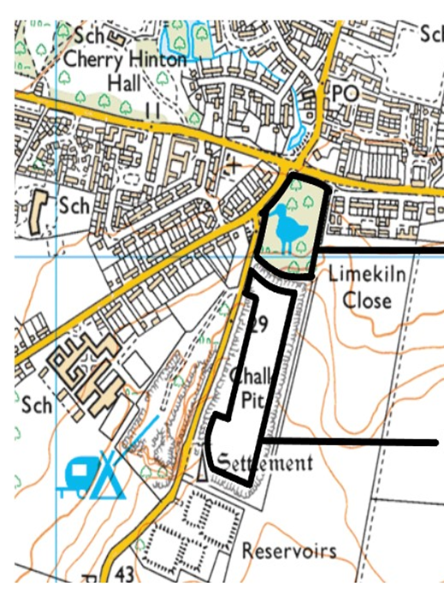
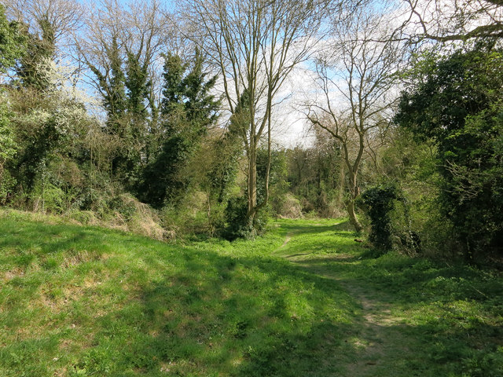
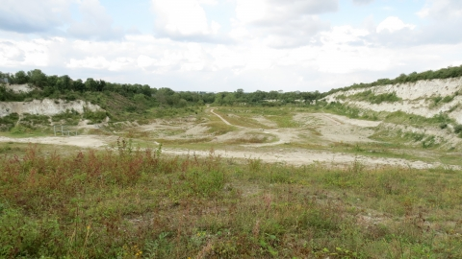
The development site – Cherry Hinton Chalk Pits
Lime Kiln Close
East Pit

Slide 5
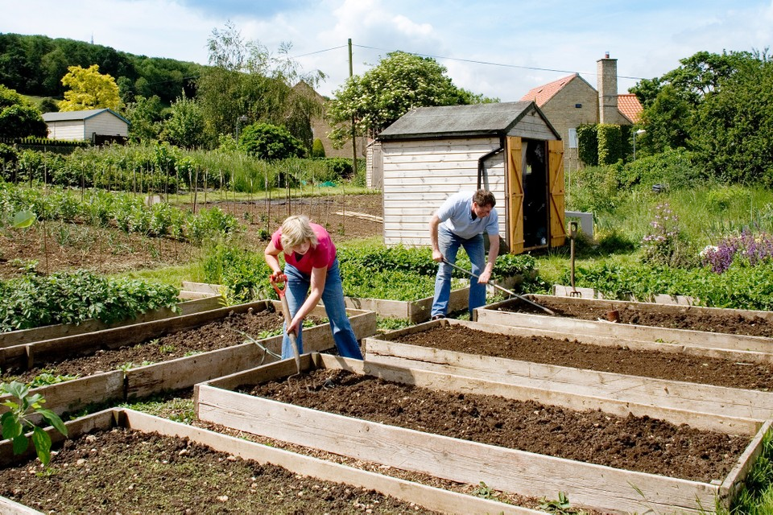
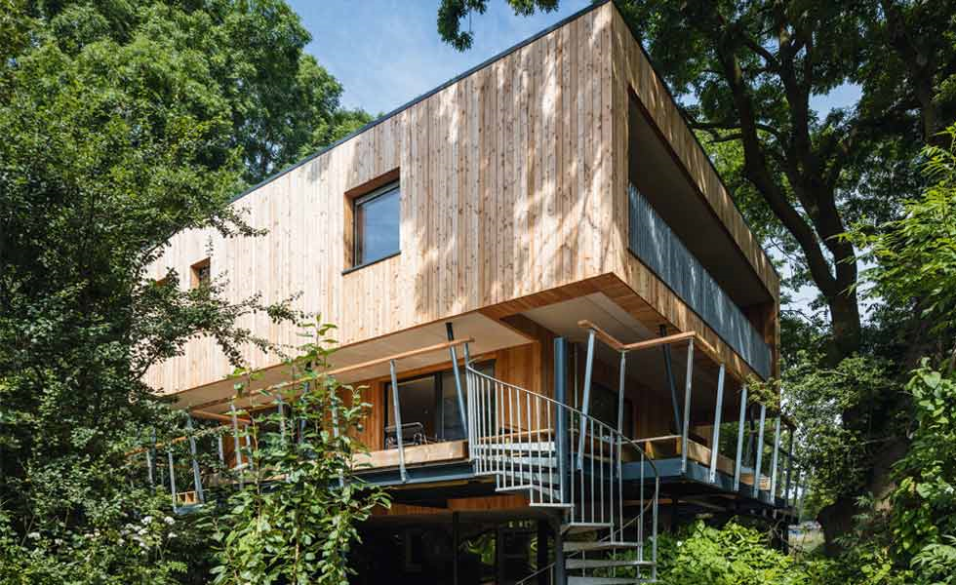
The proposed development- Cambridge's first eco-village
Community Farm
150 Eco-homes
Solar panels, green-walls

Slide 6
Your assignment
Part 1 - Establish the ecological value of the development site (40%)
Part 2 - Summarise how the development might impact the ecological value of the site (50%)
Part 3 - Provide recommendations for further surveys where you feel data is lacking (10%)
To be handed in via Turnitin by 14.00 on 16th March 2021.
Max 1500 words.

Slide 7
Part 1 Establish the ecological impact of the development site (40%)
The first part of the assignment consists of two tasks:
Task 1: Desk-based scope (30%)
Task 2: Phase-1 Habitat Survey (10%)

Slide 8
Task 1: Desk-based scope (30%)
Your first task is to conduct a desk-based scope of the Cherry Hinton Pits and the surrounding landscapes (2km radius).
Examine existing records on websites such as NBN Atlas and MAGIC.
Identify any species, habitats or ecological features that you think the planning authorities should be made aware of.
Refer back to the lecture on environmental legislation and make sure that you emphasise protected or endangered species and habitats with nature designations.
Draw attention to natural features with an important ecological role, such as water-courses, flood plains or carbon storage.

Slide 9
Task 1: Desk-based scope (30%)
Top marks go to those who:
Present their scope clearly and concisely.
Identify protected and endangered species and habitats.
Refer to relevant environmental legislation (Site designations, Birds Directive, IUCN Red List).
Identify any natural features with a major role in ecosystem functioning.
Label all tables and reference them in the text.
Example layouts will be provided on Canvas.

Slide 10
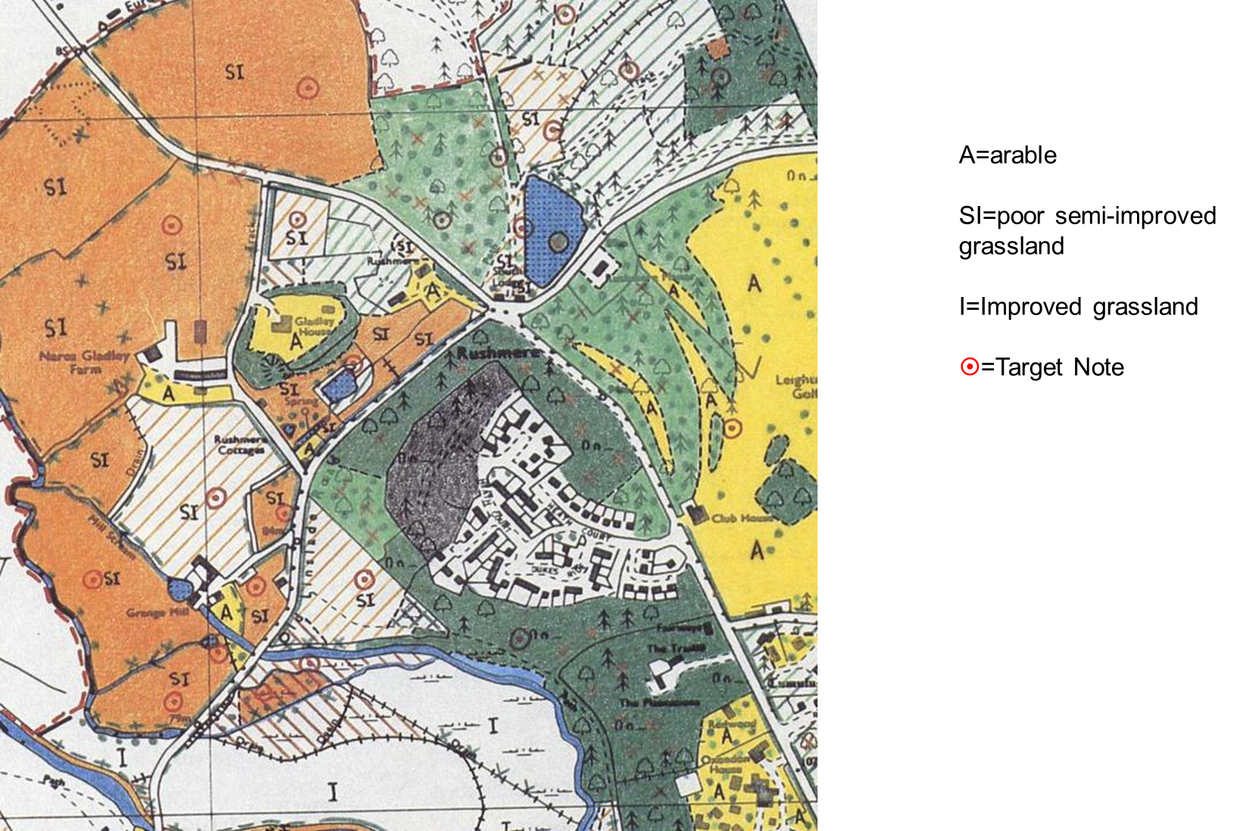
The Phase-1 Habitat Survey...

Slide 11
Types of survey Research projects: Tailored to projects, variable, non-comparable. National Vegetation Classification (NVC) Surveys: Systematic classification of UK plant communities. Standardised and repeatable. Habitats classified into sub-communities based on their dominant species Phase-1 Habitat Surveys: Broad habitat classifications, including human-modified habitats. Allows faster assessment of large areas. Does not require in-depth species knowledge.

Slide 12
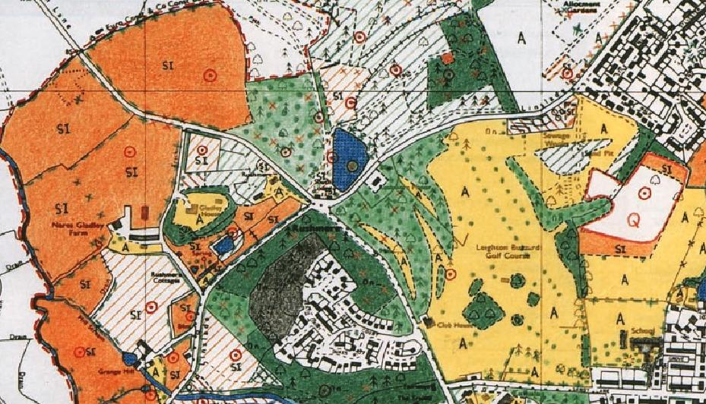
What does a Phase-1 Habitat Survey entail?
The Phase 1 classification comprises ten broad high-level categories:
A: Woodland and scrub
B: Grassland and marsh
C: Tall herb and fen
D: Heathland
E: Mire
F: Swamp, marginal and inundation
G: Open water
H: Coastland
I: Exposure and waste
J: Miscellaneous
155 sub-categories each with their own
colour and alpha-numeric code
For more details see the JNCC handbook: http://jncc.defra.gov.uk/page-4258
Notes:
Think about WHY its important to classify species.
It terms of conservation. What are the ultimate goals.

Slide 13
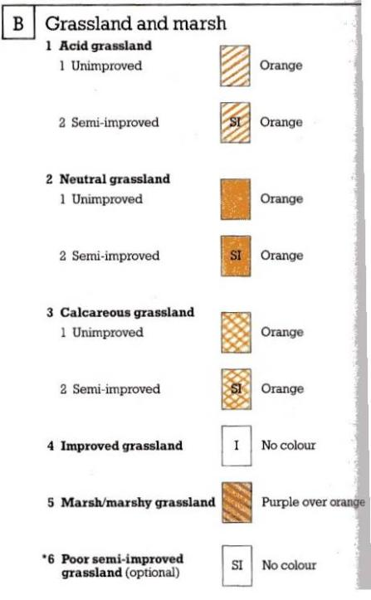
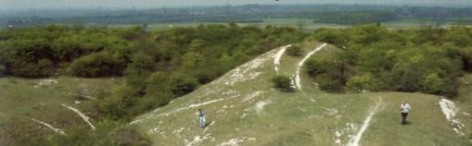
Assigning habitat categories
Looking around…
2. Finding the broad habitat category in the booklet
e.g. Grassland and marsh.
3. Considering the sub-categories and selecting the most appropriate option.
Notes:
Think about WHY its important to classify species.
It terms of conservation. What are the ultimate goals.

Slide 14
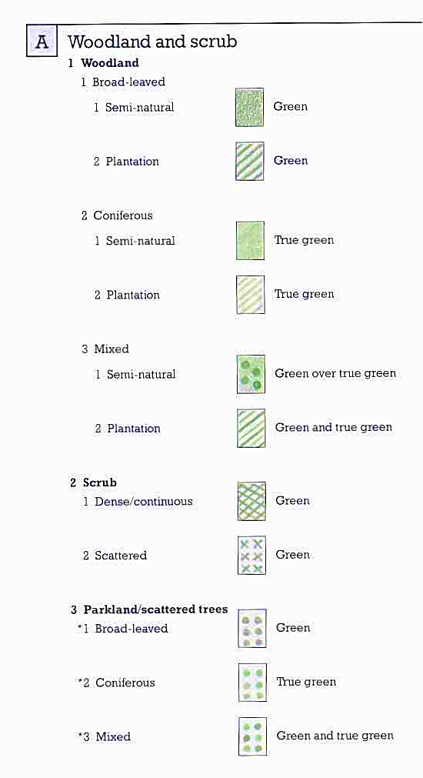
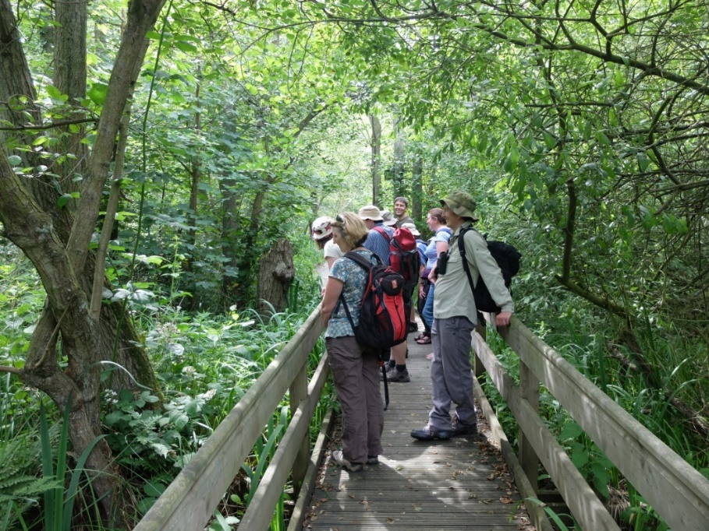
Assigning habitat categories
A1.1.1 (BW) Broadleaved, semi-natural woodland
Broadleaved woodland: 10% or less conifer
Coniferous woodland: 10% or less broadleaved
Mixed woodland: 10-90% of either broadleaved or conifer
The approximate proportions of the two types and dominant species should be target noted.

Slide 15
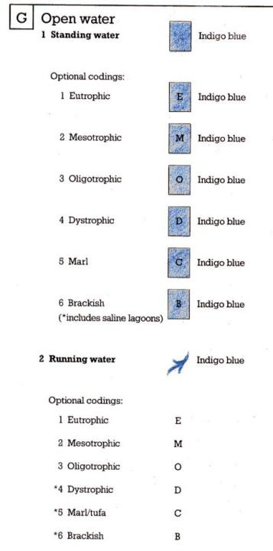
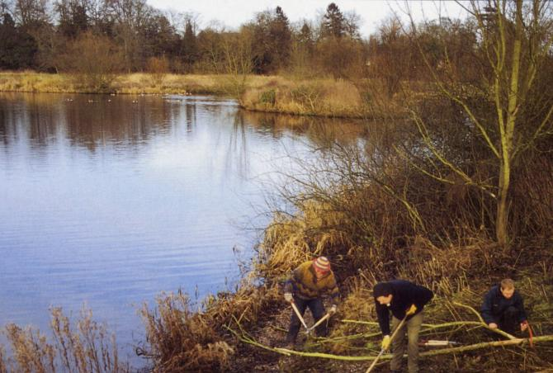
G1.2 Mesotrophic standing water
Eutrophic: Excessive nutrient content and abundance of aquatic plants (e.g. algal bloom)
Mesotrophic: Intermediate level of productivity, sometimes discoloured by planktonic algae.
Oligotrophic: Low productivity and nutrient content. Very clear water.

Slide 16
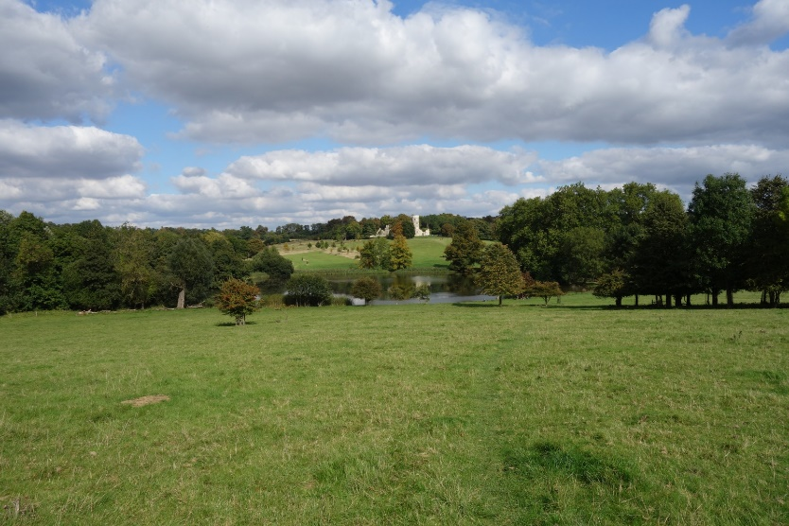
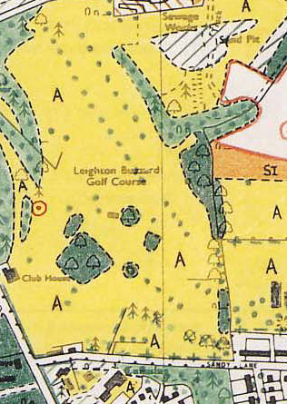
A3 Parkland and scattered trees
Tree cover < 30%
Indicate scattered trees over pasture (as in parkland) using the green dot symbol over appropriate colour
Wimpole Hall park, Cambridgeshire
Vary dot density in relation to density of trees
Dominant species should be coded.
Lines of trees (e.g. avenues) should be marked as a series of dots with the dominant species code.
Exotic trees should be target noted.
Yellow=amenity grassland

Slide 17
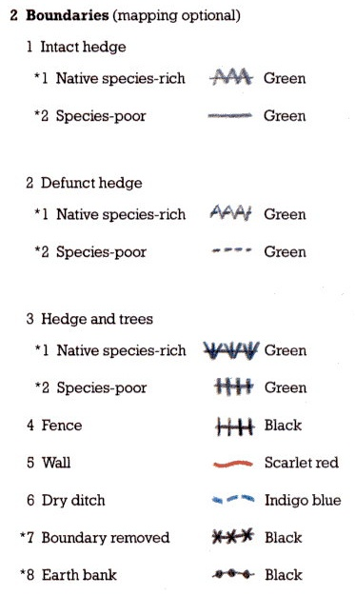
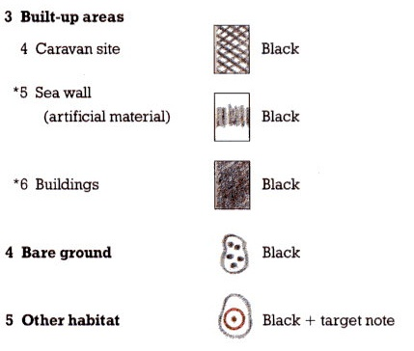
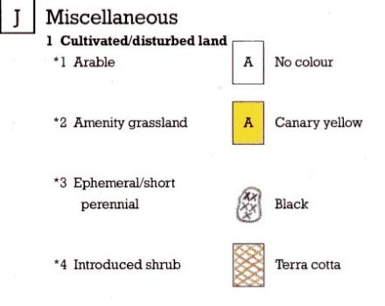

Slide 18
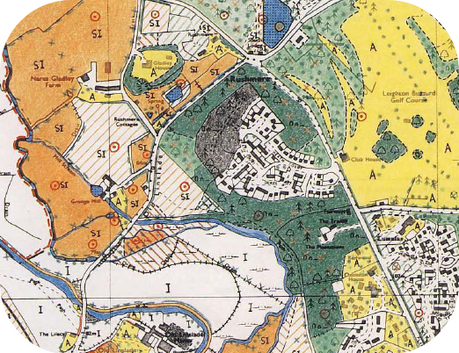
Habitat Map Example….
Habitat map and target notes.
Classify each parcel of land AND boundaries into most appropriate habitat category.
Note it on the map by Colouring [OR Alphanumeric Code (eg.G1.1) ][OR Lettered Code (e.g. SWM)]

Slide 19
Making target notes
◉
Unusual landscape features
Interesting management practices
Small areas of habitats that cannot be mapped
The composition of the plant community
Evidence of rare or protected species (nests, burrows, footprints)
Potential habitats for rare or protected species (e.g. veteran trees, fresh-water ponds).
Notes:
Not all sites need target notes - decision required on which to target note

Slide 20
Target Note example
6 figure grid reference or GPS coordinates
Date
Initials of surveyor
10227
6.10.16
ON
Fragmentary marginal vegetation occurring along 100m of the north bank of the River Ugie
Dominant species Glyceria plicata and Juncus effusus
Breeding mallard, moorhen and reed bunting
Site may warrant additional protection or survey work-suggest breeding bird survey at correct time of the year
Point of interest
Key habitat
/species
(protected?)
What are the implications?
Are additional surveys needed? Or additional conservation measures?

Slide 21
Task 2: Phase-1 Habitat Survey
As part of your Ecological Impact Assessment you should:
Present the Phase-1 Habitat Survey Map and Target Notes (which are provided on Canvas).
Provide summary text to describe the habitat types that were present.
Describe the relative extent of each habitat-type (measured as a percentage of the total area of the surveyed site).
Ensure that your map is well-presented, cited in the text and accompanied by a colour-coded legend that identifies the habitat types present at the site.

Slide 22
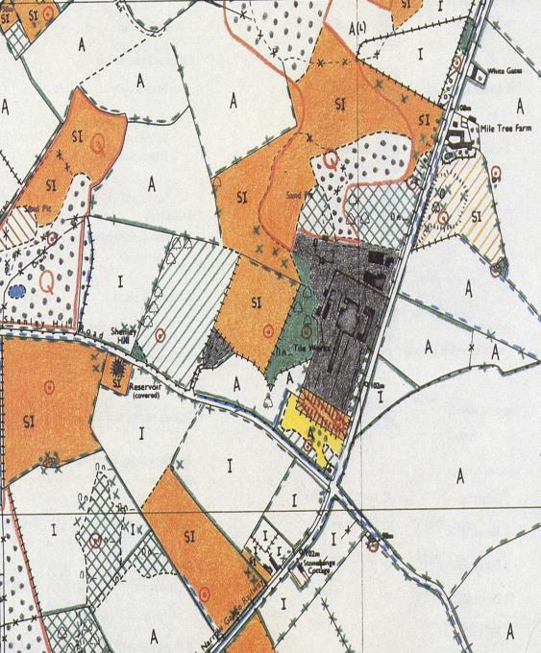
Romer dot grid to calculate area
Count all dots for mapped area
2. Count dots in each habitat category
3. Calculate percentage
E.g. 459 dots in total
75 in orange
75/459*100
= 16.3% semi-improved
neutral grassland
• • • • • • • • • • • • • • • • • • • • • • • • • • •
• • • • • • • • • • • • • • • • • • • • • • • • • • •
• • • • • • • • • • • • • • • • • • • • • • • • • • •
• • • • • • • • • • • • • • • • • • • • • • • • • • •
• • • • • • • • • • • • • • • • • • • • • • • • • • •
• • • • • • • • • • • • • • • • • • • • • • • • • • •
• • • • • • • • • • • • • • • • • • • • • • • • • • •
• • • • • • • • • • • • • • • • • • • • • • • • • • •
• • • • • • • • • • • • • • • • • • • • • • • • • • •
• • • • • • • • • • • • • • • • • • • • • • • • • • •
• • • • • • • • • • • • • • • • • • • • • • • • • • •
• • • • • • • • • • • • • • • • • • • • • • • • • • •
• • • • • • • • • • • • • • • • • • • • • • • • • • •
• • • • • • • • • • • • • • • • • • • • • • • • • • •
• • • • • • • • • • • • • • • • • • • • • • • • • • •
• • • • • • • • • • • • • • • • • • • • • • • • • • •
• • • • • • • • • • • • • • • • • • • • • • • • • • •

Slide 23
Task 2: Phase-1 Habitat Survey
Top marks will go to those who:
Present the Phase-1 Habitat Map and associated Target Notes (provided on Canvas) in a professional format.
Accompany the map with a colour-coded legend defining the JNCC Phase-1 habitat classifications.
Include figure/table legends and ensure both are cited in text.
Write a short summary paragraph including the relative extent of each habitat type (calculated as the % of the total area surveyed).

Slide 24
In your own time:
Use the NBN Atlas and Magic websites to identify which protected species and habitats have been observed within 2km of the site.
Use the JNCC Phase-1 Habitat Survey Manual to identify which habitats were recorded on the site.
Calculate the relative area of each habitat type using the Romer dot method or in ArcGIS/QGIS.
Write these findings up as the initial stage of your report.

